Slide 1
MyLCI
A little history and a few tricks

Slide 2
Application form .
Distribute the
Alpha Application for Leo Club Membership (Leo50-A) 13-18
Omega Application for Leo Club Membership (Leo50-O) 18-30
Even if you do not register your members at MyLCI you should have an Application form for every member. Do You have this?

Slide 3
A video published September 12, 2013 still shows separate login for Lions and Leos, but mentions that this would soon be a single logon to MyLCI.

Slide 4
The MyLCI logon page 2012- 3/27/2019

Slide 5
The new SIGN IN page. 3/28/2019

Slide 6
Who can sign in and change records ? [All officers can view]
To Sign in at MyLCI
You need to be a registered Leo or Leo Advisor
You need to be selected as officer
You will receive letter from LCI
Your member number (ask advisor or Ernie)
A phone number
An email Address
Maybe 1st line of mailing address
Answer security questions
And then you can sign in.
Lion Secretary
Lion President
Lion Leo Advisor
Leo Secretary
Leo President

Slide 7
Tasks at MyLCI
Register new Members
a lion must verify parental permission
Report Activities see separate sheet
View activities from other Leo Clubs

Slide 8
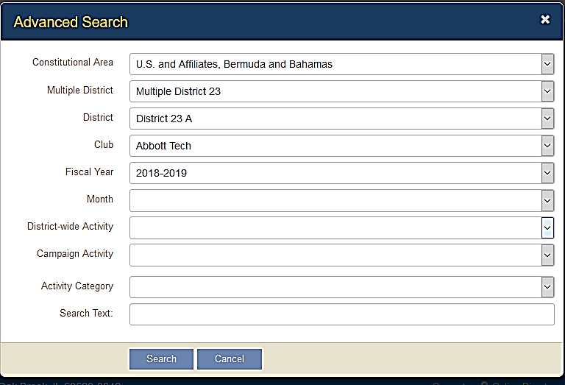
View reports (click item in Bold)
My Leo Club/Service Activities/(current month shows) ..
and a new menu item to the right
Click on Find activities/ Select Advanced Search
Click Search at bottom Get summary of whole year.
You can Add Activity here and you can Print/view
Which downloads a summary of all your reports for current year.

Slide 10
The fun begins here.
If you click the V on right end of fiscal year you will have opportunity to view but not change two previous years. (and that is just the beginning.)
Click the V at the end of the club bar and you get to view Activities in other clubs. Select club name or select the empty line and get summary of all clubs in the district. (This often takes a few minutes and sometimes crashes.

